Slide 1
LambdaConf 2018 – 6/05/2018
Metaphorisms: Deriving Divide-and-Conquer Recursive Programs from Relational Specifications
Presenter: William Harvey, PhD
Principal Engineer, OCLC
Notes:
Hi Everyone! Thank you for coming to my talk.
We talk about fear in our industry a lot. What is there to fear? Software is one of the most low-stakes things we can possibly do for a living. What does it mean for fear to be irrational?
It turns out that there is a neural circuit in our autonomic nervous system that plays a big role in our experience of fear. Like an old imperative code base, it was written into our biology by some Cambrian fish half a billion years ago. Something called the “dorsal motor nucleus of the vagus nerve” is part of it. Just like our desire to “program safely in an uncertain world,” we have to learn how to adapt our psychology and physiology around all of this old code, and not let it get the best of us.
Fear is a side effect.
What is the antidote? Laughter (via something called a “vagal brake”). Metaphors are fun and funny.
Without further ado, let’s play with metaphors and see what they can do in a functional programming setting.

Slide 2
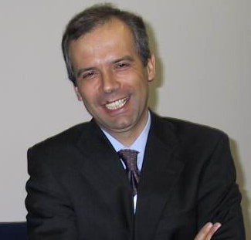
José N. Oliveira, PhD
Professor, University of Minho, Portugal
Notes:
This talk is heavily based on some very interesting work by Dr. Jose Oliveira on “Metaphorisms,” which provides a clever way to (1) write a program specification by mimicking the categorical structure of a linguistic metaphor, and (2) formulaically derive a functional program from such a specification using the Algebra of Programming (Bird-Meertens Formalism).
Dr. Oliveira, if you are listening, my apologies if we both submitted an abstract on this topic and mine was chosen over yours. Whoopsie!!!
Why am *I* qualified to give this talk? Well, I wanted to be a test pilot for this idea. While implementing a tricky algorithm, I wanted to see if this approach could make my life easier. The answer: It got me into recursion schemes and freed me from always grasping for functions when relations are a more natural fit.
Thus, for this talk, I will not be presenting his work in its full generality. Instead, I will focus on a few key examples that should be familiar to functional programmers. I hope to at least inspire you to investigate this material in greater depth.
Most importantly, I hope that you can leave this talk with some new ways of thinking about language. As a nod to Paul Snively: Make language a first-class value in your thinking!

Slide 3
Talk Overview
FP and category theory at OCLC
Our research problem
Introduction to metaphorisms
Examples

Slide 4
About OCLC
We help libraries
We’re a nonprofit global library cooperative
Thousands of library members in more than 100 countries
WorldCat: Largest online public access catalog in the world
We maintain the Dewey Decimal System

Slide 5
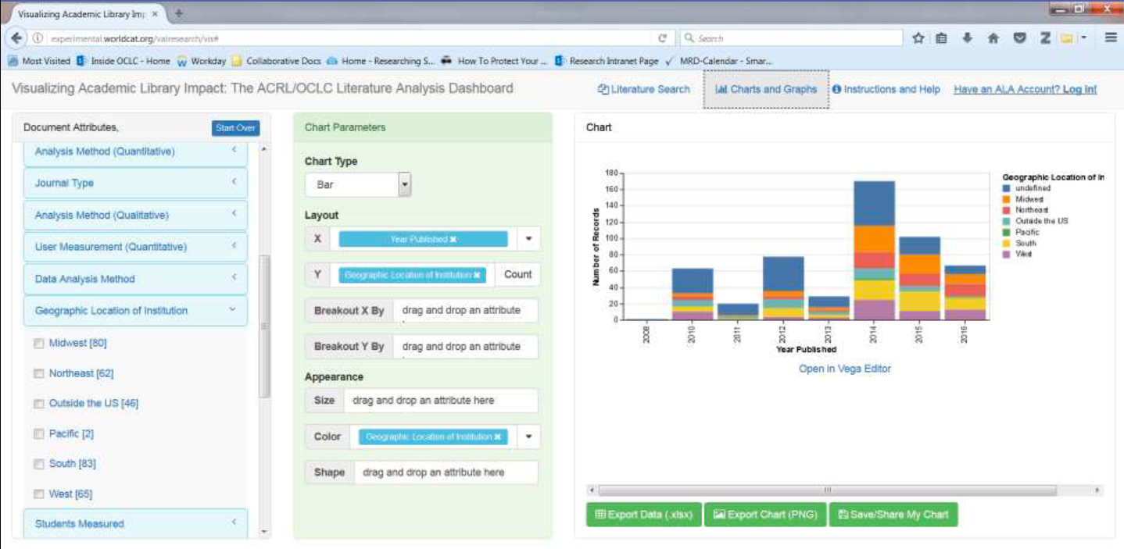
Notes:
Here is a cool, tangible example of the virtues of functional programming: A librarian-friendly visual analytics dashboard written in 100% Scala (via scala-js). Number of people: 1. Number of defects? 0.
How did I do it? Free applicative functors, bidirectional parsing. Produces/consumes Vega-Lite grammar. UI tools are wired together using functional reactive programming.
Side note: I used category theory to design the drag-and-drop interface. This was possible because I was able to represent the possible operations algebraically, and the tidiness popped out naturally.

Slide 6
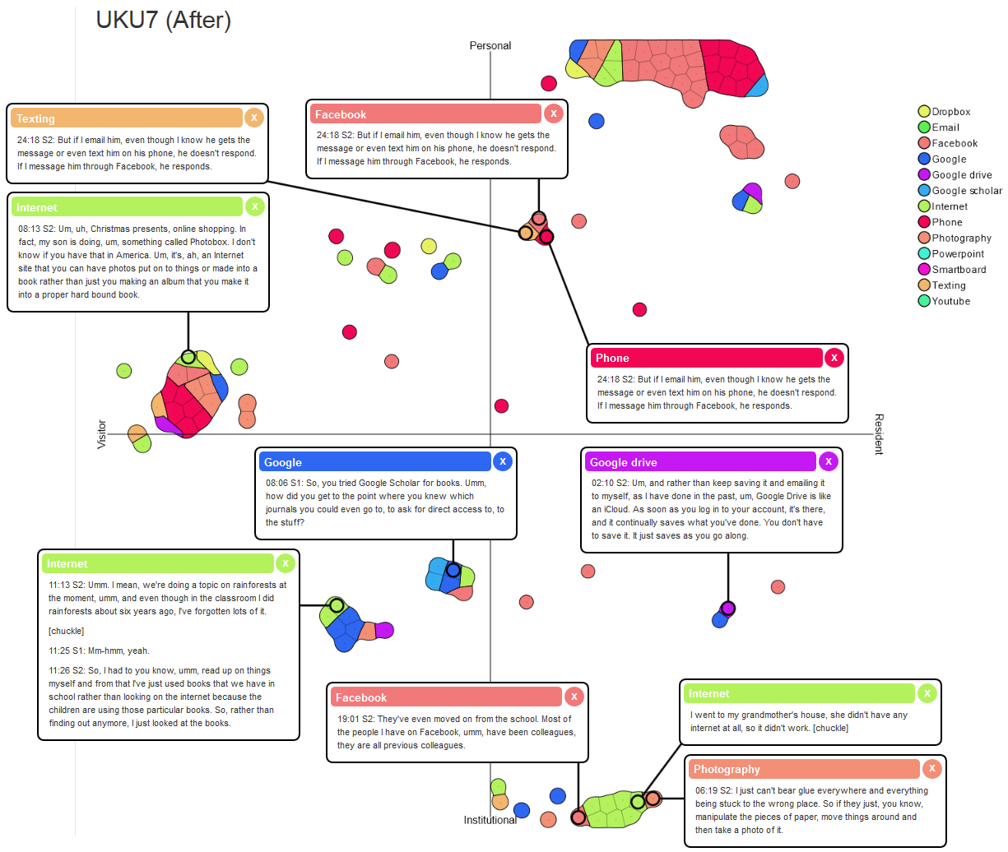
Notes:
Here is another visual analytics tool for sentiment analysis via document embedding. We aim to publish this in IEEE InfoVis or another conference. This interface made thousands of research study interview transcripts navigable and understandable! Making complex, interactive things like this is much easier when FP is around to catch your bugs!

Slide 7
Exciting Work
Big data modeling: Homotopical patch theory, groupoids, torsors, etc.
DSLs for data cleaning
Information geometry
Just starting the FP journey
Let’s talk!

Slide 8
Metaphorisms:
The motivation
Notes:
Now I would like to explain what motivated us to explore metaphorisms for our work.

Slide 9

Our Research Project
Notes:
For our research project, we wished to better understand how our users were interacting with our search engine.

Slide 10
Our Research Project
Behavioral (Clickstream) Analytics
What are users doing?
How can we assist?
Terabytes of log data
Reduced to ~100GB for our study
~5GB gzipped
Notes:
Data processing in the project was mostly behavioral (clickstream) analytics.
5 GB is small enough to fit in memory on a standard workstation. Do we really need an ElasticSearch or LogStash system to placate the 100GB of uncompressed data? Just for exploratory data analysis?

Slide 11




Rachit Agarwal, PhD
Anurag Khandelwal
Ion Stoica, PhD
Notes:
No! It turns out that there is a really cool data structure called “Succinct” that was a game changer for us.

Slide 12
Succinct
A compression format for unstructured text
Query unstructured, compressed text files directly
No data scans
No secondary indexes
No data decompression
http://succinct.cs.berkeley.edu/
Notes:
[Read off of slides.]
What do we lose?
Preprocessing is expensive
Uses some CPU for data access
Sequential scan throughput (13Mbps/thread)
In-place updates

Slide 13
Succinct Operations
s.substring(offset: Nat, length: Nat): String
s.count(str: String): Nat
s.indicesOf(str: String): [Nat]
s.findAllInRange(str1: String, str2: String): [Nat]
…etc…
Notes:
Succinct gives us all of these operations in sublinear time. Amazing! And, did I mention that this is all possible without decompressing the data?

Slide 14
Unfortunately…
Not implemented for our language
Can’t call OSS version through FFI
OSS version maxes out at 4GB (Int32)
Notes:
Unfortunately, we were unable to get enough mileage out of Berkeley’s open source implementation for a few reasons.

Slide 15
Reinventing the Wheel
Implement de novo
Port to language X
Copy/tweak
Notes:
This puts us in the usual tight place, where are options are as follows:
Implement from scratch,
Find a reference implementation and port it, or
Copy/tweak a reference implementation

Slide 16
Build You A Succinct
Two ingredients:
Compressed permutation data structure
Suffix array construction algorithm

Slide 17
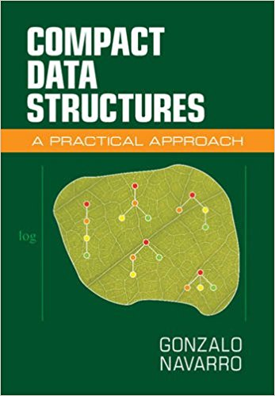
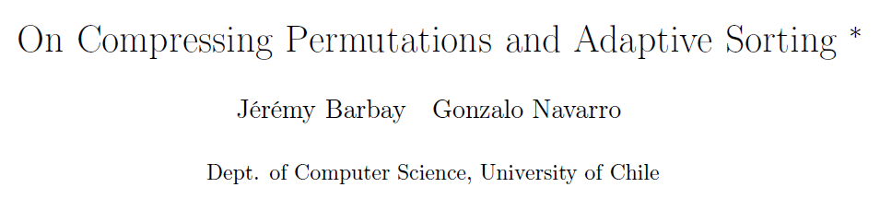

Slide 18
Suffix Array Construction
DC3 / Skew algorithm
Clever algorithm!
Divide and conquer

Slide 19
There Should Be A Better Way
Program Synthesis
Write a spec for program’s desired behavior
(Semi-)mechanically synthesize a program satisfying that spec
Notes:
Model checkers such as TLA+ are an interesting example of formal program modeling. Unfortunately, it is not (to my knowledge) possible to synthesize programs from specs – you have to write the program yourself.
Coq, agda, etc. allow program extraction. But there are steep learning curves.

Slide 20
Bird-Meertens Formalism
A categorical calculus of relations
Category theory makes it language-agnostic
Relations are more flexible than functions
Calculus makes it formulaic
Prove things!

Slide 21
Bird-Meertens Formalism
Input: A relational spec of your algorithm
Middle: Step-by-step derivation via algebraic rules
Exposes the degrees of freedom of implementation
Output: A functional program

Slide 22
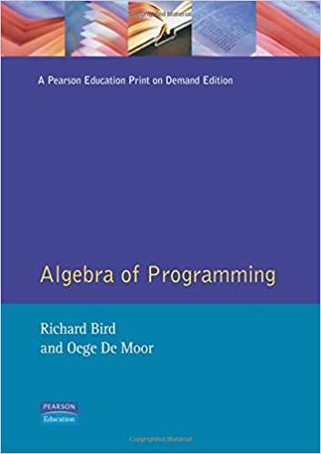
Bird-Meertens Formalism
Dynamic programming
Greedy algorithms
Exhaustive search
Divide and conquer
And more!
Notes:
There is an excellent book called “Algebra of Programming” that provides a great introduction to the Bird-Meertens formalism. The book walks us through the design and implementation of myriad algorithms, including those based on the characteristics shown here.

Slide 23
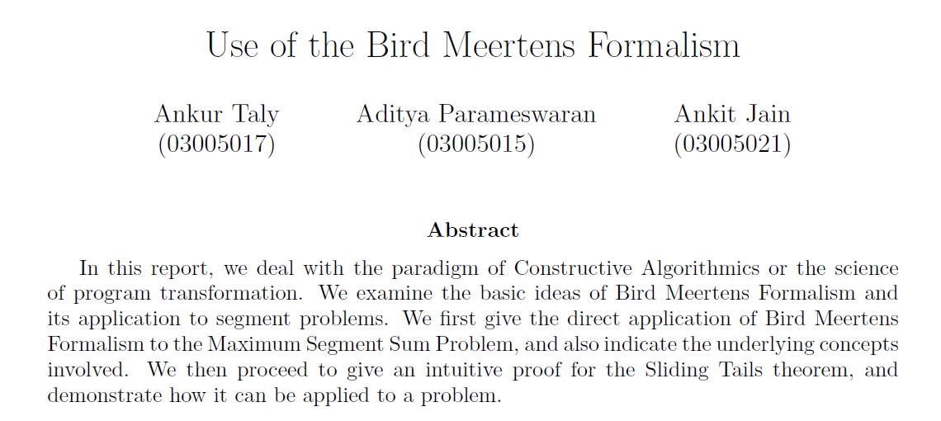
Notes:
More proof that the Bird-Meertens Formalism is useful: This paper uses it to derive an algorithm for the Maximum Segment Sum Problem, AND to prove the Sliding Tails theorem.
Why hasn’t the Bird-Meertens Formalism caught on? Possibly because relations are more powerful than functions, and there are a lot more rules to learn when combining them together. Also, the Bird-Meertens Formalism is formulated in a language-agnostic way, so it takes some study time to learn how it maps on to your favorite programming language.
How many of you are new to recursion schemes? Bird-Meertens Formalism uses these as basic building block.
Also, there is much mathematical language used in the proofs, like sudden proclamations of “Leibniz!” in the middle of a proof.

Slide 24
Metaphorisms
BMF-style relational program specifications…
…defined over inductive types…
…that mimic formal metaphors!
Notes:
What are Metaphorisms? They are BMF-style relational program specifications, defined over “inductive types,” …that mimic formal metaphors!

Slide 25
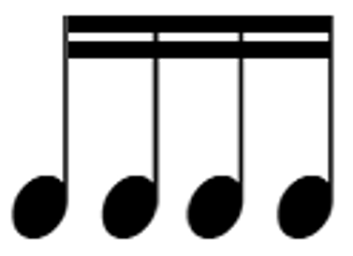
Metaphors
“Time is money.”
“All the world’s a stage.”
“A monad is a burrito.”
“Monads are trees with grafting.”
“Some say love…it is a razor…”
Notes:
Anyone familiar with the pure functional Cord data structure? Well, look no further: My dysfunctional vocal cord.

Slide 26
Metaphors in Software
Tree
Pipe
Stack
Heap
Queue
Spaghetti code
Bug

Slide 27
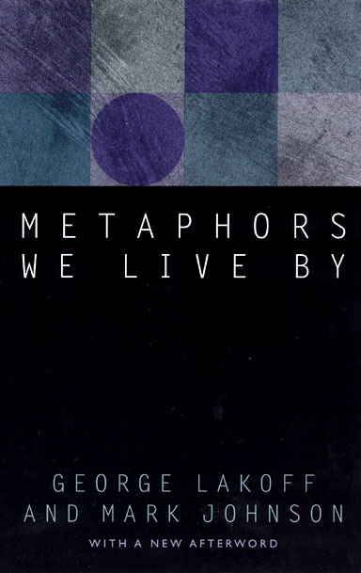
Notes:
Metaphors are absolutely pervasive. Like adjunctions in everyday life, once you are trained to recognize them you will notice them everywhere. And life will never be the same. Metaphors form our reality.
Metaphors appear to be critical to learning intuition behind things. Non-FP developers often do not have an intuition for a “monad” or an “applicative” or “traversable.” This may explain the outcropping of monad tutorials that try to rely on metaphors to transmit the meaning of a monad in terms of more familiar concepts.

Slide 28
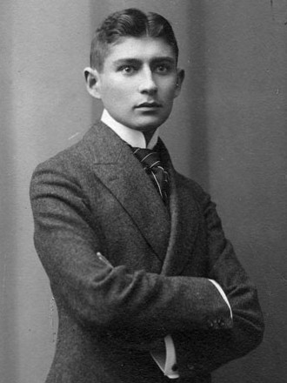
Formal Metaphors
Three components:
A tenor (“Love”)
A vehicle (“A Razor”)
A shared attribute (“Ouch!”)
“Love is, that you are the knife which I plunge into myself.”
-Franz “Streaming” Kafka
Notes:
Try not to confuse Kafka’s “The Metamorphosis” with “metaphorisms” or “metamorphism” (a fold followed by an unfold). Kafkaesque terminology, though Kafka had nothing to do with it.

Slide 29
Metaphors, Categorically
Tenor
Vehicle
f
g
Attribute
Notes:
Categorically, a metaphor begins with a cospan in the category of sets. Here, f and g are functions (morphisms in the category of sets). These functions extract, from the tenor and vehicle, the shared attribute.

Slide 30
Metaphors, Categorically
f ∘·g
Tenor
Vehicle
f ∘
f
g
Attribute
Notes:
The witty power of a metaphor comes from two features: The first one is to imply that “Tenors are Vehicles” by following g, then going “backwards” through f. “Where there’s a vehicle, there’s a tenor…”
In a moment, I will explain what it means to go “backwards” through a function. As functional programmers, this does not seem generally possible!

Slide 31
Metaphors, Categorically
f ∘·g
Tenor
Vehicle
f
g
Attribute
Notes:
The second feature is to leave part of the metaphor up to the imagination: By not spelling out the shared attribute explicitly, you let the listener stumble upon it. A guffaw, snort, or lightbulb ensues.

Slide 32
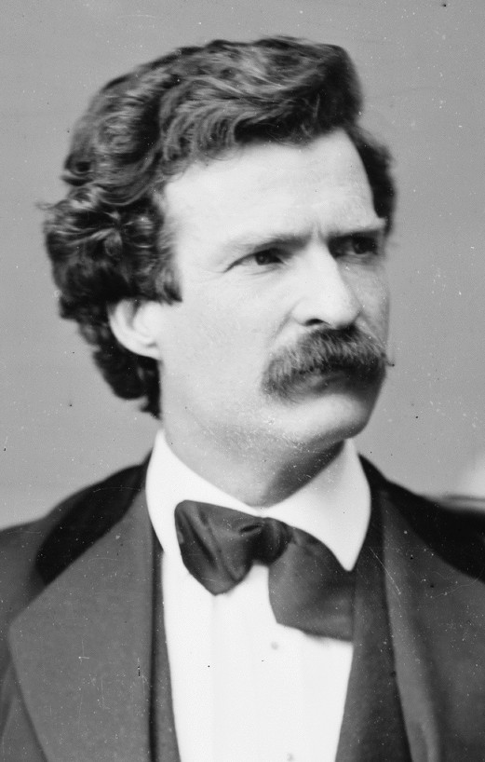
“Politicians and diapers must be changed often, and for the same reason.”
-Mark Twain
Notes:
Here is a concrete example of a humorous metaphor.

Slide 33
Tenor
“Politicians and diapers must be changed often, and for the same reason.”
-Mark Twain
Notes:
Here is a concrete example.

Slide 34
Vehicle
“Politicians and diapers must be changed often, and for the same reason.”
-Mark Twain
Notes:
Here is a concrete example.

Slide 35
“Politicians and diapers must be changed often, and for the same reason.”
-Mark Twain
Shared attribute hint
Notes:
Here is a concrete example.

Slide 36
“Politicians and diapers must be changed often, and for the same reason.”
-Mark Twain
Shared attribute hint
Notes:
Here is a concrete example.

Slide 37

Metaphors, Categorically
Politicians
Diapers
f
g
Notes:
We have the set of all Politicians, and the set of all Diapers. The functions “f” and “g” extract the attribute-that-shall-not-be-named (“dirty”).

Slide 38
Metaphors, Categorically
f ∘·g
Politicians
Diapers
f ∘
f
g
Notes:
We construct the unique morphism f-converse after g, which implies that Politicians are Diapers.

Slide 39
Metaphors, Categorically
f ∘·g
Politicians
Diapers
f ∘
f
g
Notes:
Finally, we hide the shared attribute from the listener, alluding to it just enough. Then the dominoes tip over in the listener’s mind, two-and-two are put together, and the “ah ha that is clever” remark is achieved. “Both must be changed often, and for the same reason.”

Slide 40
Interlude: Function Converse
A
B
Notes:
As functional programmers, we have certain intuition about functions. We know that not all functions are invertible! Certainly, computations are not generally invertible (reversable). So what does it mean to move “backwards” through a function?
Let’s start by thinking about the definition of a function. A function maps each element in a set (say, set “A” here), to exactly one element in another set (say set “B”) here.

Slide 41
Interlude: Function Converse
A
B
f : A → B
Notes:
Here is an example of one possible function from A to B. We call this function f. Does this function have an inverse?
Let’s flip around all the arrows.

Slide 42
Interlude: Function Converse
A
B
f ⁻¹ : B → A
Notes:
Now we have a mapping from elements of B to elements of A.

Slide 43
Interlude: Function Converse
A
B
f ⁻¹ : B → A
Notes:
However, this violates the definition of a function, because that bottom item in B is not going to exactly one element in A.
What do we do?

Slide 44
Interlude: Function Converse
A
B
f ∘ : B → A
Notes:
Well, functions are just special cases of binary relations. Binary relations between a pair of sets A and B are just subsets of their Cartesian product.
Every function is a binary relation. But not every binary relation is a function.
By “relaxing” your functions into binary relations, you can start thinking about things relationally rather than “directionally.” The mental and mechanical freedom can be liberating.
However, depending on your opinion of the modern SQL landscape, we sort of got off to a bad start with relational thinking…

Slide 45
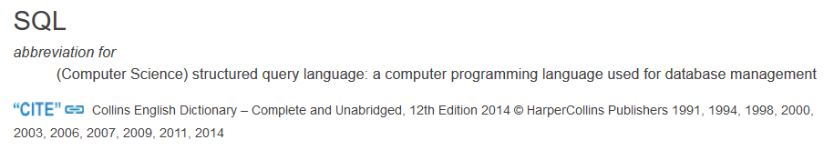
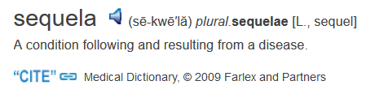
“sequel”
Notes:
Do these two words have common etymology?
(Anyone see the intrinsic metaphor that makes this funny?)

Slide 46
Example: Text Formatting
format
[String]
String
(e.g., word wrap, scalariform, gofmt, etc.)
Notes:
It turns out that we can build relational specifications for computer programs that look like linguistic metaphors. Let’s try to do “string formatting.” The input is a string, and the output is the string all chopped up nicely across multiple lines, and with lots of pretty whitespace added.
Some examples of formatting functions could include word wrap, scalariform, and gofmt.
As we build this spec, we will have to first pick the hidden attribute that must be preserved. Then, we will have to devise another way to choose among many possible outputs that preserve the shared attribute.

Slide 47
Example: Text Formatting
format
[String]
String
Notes:
“A formatted string…”

Slide 48
Example: Text Formatting
format
[String]
String
Notes:
“…is a sequence of strings…”

Slide 49
Example: Text Formatting
format
[String]
String
(>>= words)
words
[String]
Notes:
“…that contains the same sequence of words as the input…” (…aaand, there is nice beautiful whitespace and neat newlines added.) Encoding that latter part into the diagram will take some additional work. Let’s poke around pointwise to find out what needs to be done.

Slide 50
Example: Text Formatting
format
[String]
String
(>>= words)∘
words
[String]
Notes:
First, flip around the “bind words” function by taking its converse.

Slide 51
Example: Text Formatting
format
[String]
String
(>>= words)∘
words
[String]
Notes:
Now we’ll put a thing through the green path to see what happens.

Slide 52
Example: Text Formatting
[ “foo”, “bar”, “baz” ]
words
“foo bar baz”
Notes:
Consider the input string “foo bar baz”, on the right. The output of the “words” function is a list, of length 3, containing the sequence of words in the input string, namely: “foo”, then “bar”, then “baz”.

Slide 53
Example: Text Formatting
[ “foo”, “bar”, “baz” ],
[ “foo bar”, “baz” ],
[ “foo”, “bar baz” ],
[ “ foo bar baz”]
[“ foo”, “ bar”, “ baz”]
…
…etc.
(>>= words) ∘ · words
“foo bar baz”
Notes:
Now let’s compose that with “bind words converse”. Unfortunately, the output that we get is an infinite set of string lists. Each string list in the set contains its own unique distribution of whitespace.
Oliveira states that, if we can define an endo-relation on this set that helps us choose which of these word lists we like more than others, we can plug the endo-relation into our diagram and (in principle) derive a program.

Slide 54
Example: Text Formatting
[String]
better
(>>= words) ∘ · words
[String]
String
(>>= words)
words
[String]
Notes:
Let’s call this endorelation “better,” shown in blue above. Given a list of strings, it hands us back a string that is formatted “better” according to our formatting preferences.

Slide 55

Example: Text Formatting
[String]
format =
better
((>>= words) ∘ · words) better
(>>= words) ∘ · words
[String]
String
(>>= words)
words
[String]
Notes:
Finally, we introduce a relational “shrink” operator pronounced “shrunk by.” What does it do?
“Consider the relation on the left side of the “shrink” operator. Take its outputs, and emit a ‘best’ output according to the criterion on the right.” Think of it as a quality control filter. Or an optimization criterion. It takes a thing and returns an “embettered” version of that thing.
What does the spec for our format function mean? It optimizes whitespace while preserving the word sequence.
When the objects in this diagram are represented in the programming language of your choice as inductive (sometimes called “recursive”) types, Oliveira calls this pattern a metaphorism.
The promise is as follows: Assuming you can come up with a suitable criterion for your “better” relation, and you can represent the objects above as inductive (recursive) types, the “Algebra of Programming” provides you with a formulaic and mostly mechanical way to translate this diagram into a functional program. (In squiggol.) This functional program will be built up of anamorphisms (unfolds) and catamorphisms (folds) that are typically combined into a hylomorphism.

Slide 56
Divide and Conquer Algorithms
Objects: Inductive types
Arrows: Ana- and catamorphisms
How?
Introduce an intermediate inductive type
Plug in a hylomorphism
Notes:
The previous diagram does not facilitate describing algorithms that have some “divide and conquer” nature to them. (Divide and conquer is a metaphor, by the way.)
To do this, we have to do two things to our previous diagrams:
Introduce an intermediate inductive type in the middle of the diagram that serves as the cream filling in the middle of the Divide and Conquer Oreo.
Express the divide and conquer in the form of a hylomorphism.

Slide 57
Divide and Conquer Algorithms
T
W
V
f
g
A
Notes:
First, we have to introduce an auxiliary type W. This type will be produced by an anamorphism, then consumed by a catamorphism. (What is this called??? Hylomorphism!) It “disappears” (a so-called “virtual data structure”) because it is only used internally by the hylomorphism.
Next, we go from V to T through W. We have (at least) a couple of canonical ways to do this:

Slide 58
“Easy Divide, Hard Conquer”
Y
h∘
T
W
V
f
g
A
Notes:
For an “Easy divide, hard conquer” formulation, catamorphism h is usually a super-straightforward conversion between types W and V. The hard work of preserving the invariant and doing the optimization goes into Y.
Cool trick: Oliveira gives us a formula dictating what Y should be.
Think: Mergesort. Dividing the input list into parts is trivial, but conquering requires a careful merge of sorted lists.

Slide 59
“Hard Divide, Easy Conquer”
h
X
T
W
V
f
g
A
Notes:
The other canonical method is “Hard Divide, Easy Conquer.” In this setting, we expend a lot of effort “dividing” V by representing it as inductive type W (via anamorphism) through some “heavy-duty” relation or function X. Once that is done, the catamorphism converting W to T is usually trivial.
Cool trick: Oliveira gives us a formula for what X should be.
Think: Quicksort. Partitioning a list requires careful selection of a pivot! But conquering (merging) the sorted lists is trivial.

Slide 60
Example: Sorting a List
sort
List[T]
List[T]
Notes:
Since we’ve been discussing sorting, let’s work an example. First, we will assemble a relational specification for sorting in the form of a metaphor. Then we will show how to transform that into cata-, ana-, and hylomorphisms over inductive types.
Here is the basic type signature of a sorting function: It transforms a list into a list, sorting it as it goes.

Slide 61
Example: Sorting a List
bag ∘ · bag
List[T]
List[T]
bag
bag
Bag[T]
Notes:
What is the shared attribute of our metaphor? Well, sorting preserves the elements of a list. We encode this by showing that a list and its sorted doppelganger should be equivalent under “bag semantics.”
Moving across that top morphism there: When we convert a list to a bag, then go backwards through the bag function, we get all possible permutations of a list.

Slide 62
Example: Sorting a List
List[T]
???
bag ∘ · bag
List[T]
List[T]
bag
bag
Bag[T]
Notes:
Our “optimization” criterion must redirect each unsorted list to its sorted self. How does one squeeze this into the diagram above?
We really want to just plug in a predicate postcondition that takes a list and answers the question, “Is this list sorted?”. But the type signature for that is usually List[T] -> Bool. How do we encode it as a List[T] -> List[T]?

Slide 63
Example: Sorting a List
List[T]
???
List[T]
Notes:
Here is the upper-left part of the diagram, into which we want to put a binary predicate.

Slide 64
Example: Sorting a List
List[T]
???
List[T]
Notes:
We’ll add the Booleans into the diagram.

Slide 65
Example: Sorting a List
ordered
List[T]
???
List[T]
Notes:
The function ordered here is the one we’d expect: It returns true when a list’s items are in order, and false otherwise.

Slide 66
Example: Sorting a List
ordered
List[T]
true
???
List[T]
Notes:
The function true here ignores its input and always returns true.

Slide 67
Example: Sorting a List
ordered ∘
List[T]
true
???
List[T]
Notes:
Now flip the “ordered” arrow around by taking its converse.

Slide 68
Example: Sorting a List
ordered ∘
List[T]
true
ordered ∘ · true
List[T]
Notes:
The composition of these two relations gives us the set of all possible sorted lists. Think about this for a second. Is this what we needed to complete our diagram?
Yes! We combine this with our “shared attribute” to ignore lists that have different elements than our input.

Slide 69
Example: Sorting a List
List[T]
sort =
ordered ∘ · true
(bag ∘ · bag) (ordered ∘ · true)
bag ∘ · bag
List[T]
List[T]
bag
bag
Bag[T]
Notes:
By following the metaphorism recipe, any sorting algorithm will obey this relational specification. Intuitively, what does it mean?
“A sorting algorithm generates a permutation of an input list such that its elements are in order.”
This looks pretty good so far, but what’s up with that “shrinking” operator? Well, it turns out we can get rid of it.

Slide 70
Example: Sorting a List
List[T]
sort =
ordered ∘ · true
(ordered ∘ · true) · (bag ∘ · bag)
bag ∘ · bag
List[T]
List[T]
bag
bag
Bag[T]
Notes:
When our optimization criterion is a predicate postcondition, the shrink operator reduces to reverse relation composition.
This is a complete relational spec for a sort function.

Slide 71
Program synthesis
Notes:
Now let’s explore transforming this specification into a functional program.

Slide 72
Example: “Mystery Sort"
Start with a “Divide and Conquer” template
Plug in bits/pieces of our spec for sort
Turn the crank!

Slide 73
Example: “Mystery Sort”
List[T]
sort =
ordered ∘ · true
(ordered ∘ · true) · (bag ∘ · bag)
bag ∘ · bag
List[T]
List[T]
bag
bag
Bag[T]
Notes:
Start with the relational spec for our sort function.

Slide 74
Example: “Mystery Sort”
List[T]
sort =
ordered ∘ · true
(ordered ∘ · true) · (bag ∘ · bag)
List[T]
List[T]
bag
bag
Bag[T]
Notes:
Clear out some space in the middle for our “intermediate data structure,” per the recipe given to us by Oliveira.

Slide 75
Example: “Mystery Sort”
List[T]
sort =
ordered ∘ · true
(ordered ∘ · true) · (bag ∘ · bag)
List[T]
Tree[T]
List[T]
bag
bag
Bag[T]
Notes:
Here, we use a “leafy tree,” in which the values are stored at the leaves.

Slide 76
Example: “Mystery Sort”
List[T]
sort =
ordered ∘ · true
(ordered ∘ · true) · (bag ∘ · bag)
tips
List[T]
Tree[T]
List[T]
bag
bag
Bag[T]
Notes:
According to the “Easy divide, hard conquer” recipe, we need a function that will turn a binary tree into a list. Let’s call this function “tips,” as it plucks off the tips (leaves) of the tree, storing them in a list using in-order traversal.

Slide 77
Example: “Mystery Sort”
List[T]
sort =
ordered ∘ · true
(ordered ∘ · true) · (bag ∘ · bag)
Y
tips
List[T]
Tree[T]
List[T]
bag
bag
Bag[T]
Notes:
Now, we must find some function Y

Slide 78
Example: “Mystery Sort”
Lemma (trust me…):
sort
= (ordered ∘ · true) · (bag ∘ · bag)
= (ordered ∘ · true) · bag ∘ · bag · tips · tips ∘
Y

Slide 79
Example: “Mystery Sort”
Punchline: A function satisfying Y is the “list merge” seen in merge sort.
We have derived Merge Sort!
Different choices lead to different sorting algorithms

Slide 80
conclusion

Slide 81
Conclusion
Metaphors are everywhere
We can use them in programming
The Bird-Meertens Formalism is cool
Functions to relations
Keep climbing the ladder of abstraction

Slide 82
Meta-metaphors?
Burning the candle at both ends
Might seem super-neat,
But I’ll guarantee it’s not the way
To make our two ends meet!
-Ruth M. Walsh

Slide 83
acknowledgements

Slide 84


William Harvey, PhD
Principal Engineer, OCLC
Lynn Silipigni Connaway, PhD
Senior Research Scientist & Director of User Research, OCLC

Slide 85


Erin M. Hood
Research Support Specialist, OCLC
Brittany Brannon
Research Assistant, OCLC

Slide 86
Thank You!
William Harvey, PhD
Principal Engineer
harveyw@oclc.org

